Slide 1
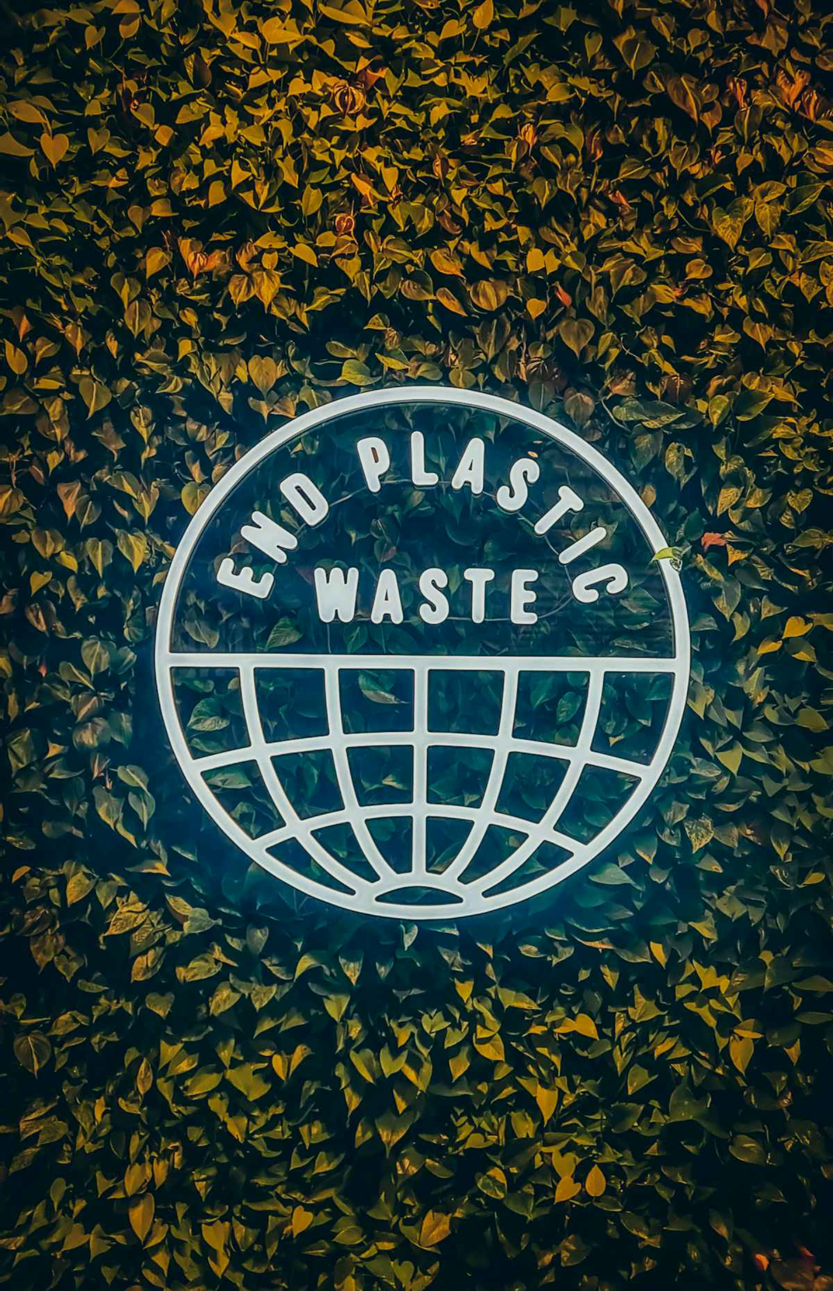
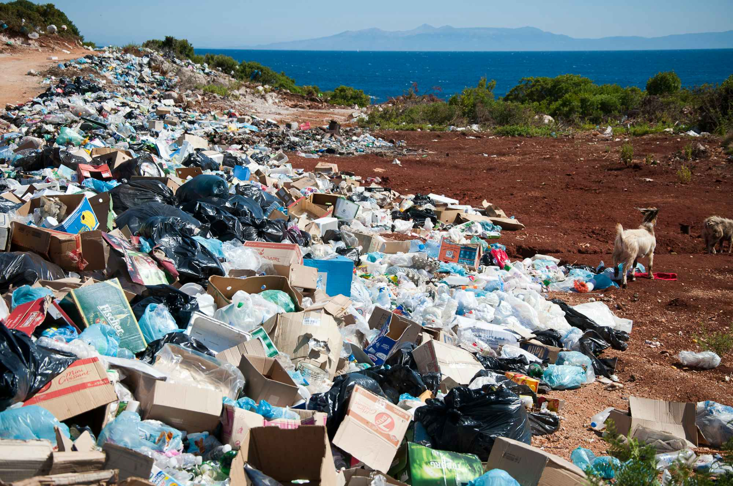
Green Fabric – Sustainable Fashion Technology
Green Fabric is a pioneering fashion technology startup revolutionizing the textile industry through innovative recycling solutions. We transform discarded PET plastic bottles into high-quality recycled polyester fabric, creating sustainable materials for apparel and home textiles while actively combating the global plastic waste crisis.
Our mission extends beyond fabric production – we're building a circular economy where waste becomes valuable resources. By converting billions of plastic bottles that would otherwise pollute landfills and oceans into premium textiles, we're proving that environmental responsibility and commercial success can go hand in hand. Every yard of our fabric represents a step toward a more sustainable future for fashion.

Slide 2
The Global Plastic Waste Crisis
350M
91%
8.3B
Tonnes of Plastic Waste
Not Recycled
Tonnes Total
Produced globally every year, creating an environmental emergency
Most plastic waste ends up in landfills, oceans, or incinerated
Cumulative plastic produced since the 1950s worldwide
The world faces an unprecedented plastic waste crisis that threatens our planet's ecological balance and human health. According to Our World in Data, we produce approximately 350 million tonnes of plastic waste annually, with production rates accelerating faster than our ability to manage disposal responsibly.
This massive volume of waste overwhelms existing infrastructure, leading to widespread environmental pollution. Mismanaged plastic waste clogs drainage systems, contaminates soil and water sources, and creates floating garbage patches in our oceans. Marine ecosystems suffer devastating impacts as sea life ingests plastic debris or becomes entangled in waste, disrupting food chains and biodiversity.
The scale of this challenge demands immediate, innovative solutions that transform waste streams into valuable resources, creating economic incentives for proper waste management while addressing environmental concerns.

Slide 3

$1.5 Trillion Health Crisis
Plastic Pollution's Hidden Health Toll
The plastic waste crisis extends far beyond environmental damage – it's creating a global health emergency of staggering proportions. A comprehensive report published in The Lancet warns of a $1.5 trillion annual health crisis directly linked to plastic pollution, affecting human health from infancy through old age.
Microplastics, tiny particles less than 5mm in diameter, have been detected in human organs including the lungs, liver, kidneys, and even placental tissue. These particles carry toxic chemicals including phthalates, bisphenol A (BPA), and flame retardants that can disrupt endocrine function, cause reproductive issues, and potentially increase cancer risks.
The health impacts are particularly severe for vulnerable populations. Children face developmental risks from early exposure, while pregnant women may transfer contamination to developing fetuses. Communities near plastic production facilities and waste sites experience disproportionately higher rates of respiratory diseases and other health complications.
"Plastic pollution is not just an environmental issue – it's a public health crisis requiring urgent action across industries and governments."
Reference: The Guardian Health Crisis Report

Slide 4



Polyester: From Waste to Resource
PET Bottles
Transformation
Premium Textiles
Billions of discarded plastic bottles become raw materials for sustainable textile production
Advanced recycling technology converts waste into high-quality polyester fibers
Recycled polyester fabrics match virgin material quality while reducing environmental impact
Polyester represents one of the most significant opportunities in sustainable textile production. As the world's most widely used synthetic fiber, polyester accounts for over 50% of global fiber production, primarily derived from petroleum-based resources. However, polyester's molecular structure makes it perfectly suited for recycling from PET plastic bottles.
The recycling process transforms what was once considered waste into valuable resources, creating a circular economy model that reduces dependence on virgin petroleum resources. Each ton of recycled polyester saves approximately 2 tons of CO2 emissions compared to virgin polyester production, while simultaneously diverting plastic waste from landfills and oceans.
This transformation addresses multiple challenges simultaneously: reducing plastic waste, decreasing greenhouse gas emissions, conserving petroleum resources, and meeting growing demand for sustainable textiles in the fashion industry.

Slide 5
Our Production Process
01
02
Collection & Sorting
Cleaning & Preparation
PET bottles are collected from recycling centers and sorted by color and quality to ensure optimal processing results
Bottles undergo intensive cleaning to remove labels, adhesives, and contaminants, ensuring purity for textile production
03
04
Mechanical Processing
Melting & Extrusion
Clean bottles are shredded into uniform flakes and washed again to achieve the highest quality standards
Flakes are melted and extruded through spinnerets to create continuous polyester filaments
05
06
Fiber Production
Fabric Manufacturing
Filaments are drawn, crimped, and cut into staple fibers ready for spinning into yarn
Yarns are woven or knitted into finished fabrics, ready for apparel and home textile applications
Our state-of-the-art production process combines advanced recycling technology with traditional textile manufacturing expertise. We maintain strict quality control at every stage, ensuring our recycled polyester fabrics meet or exceed industry standards for durability, colorfastness, and performance characteristics.

Slide 6
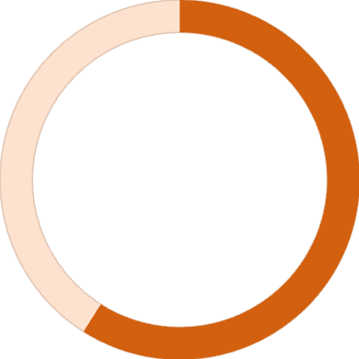
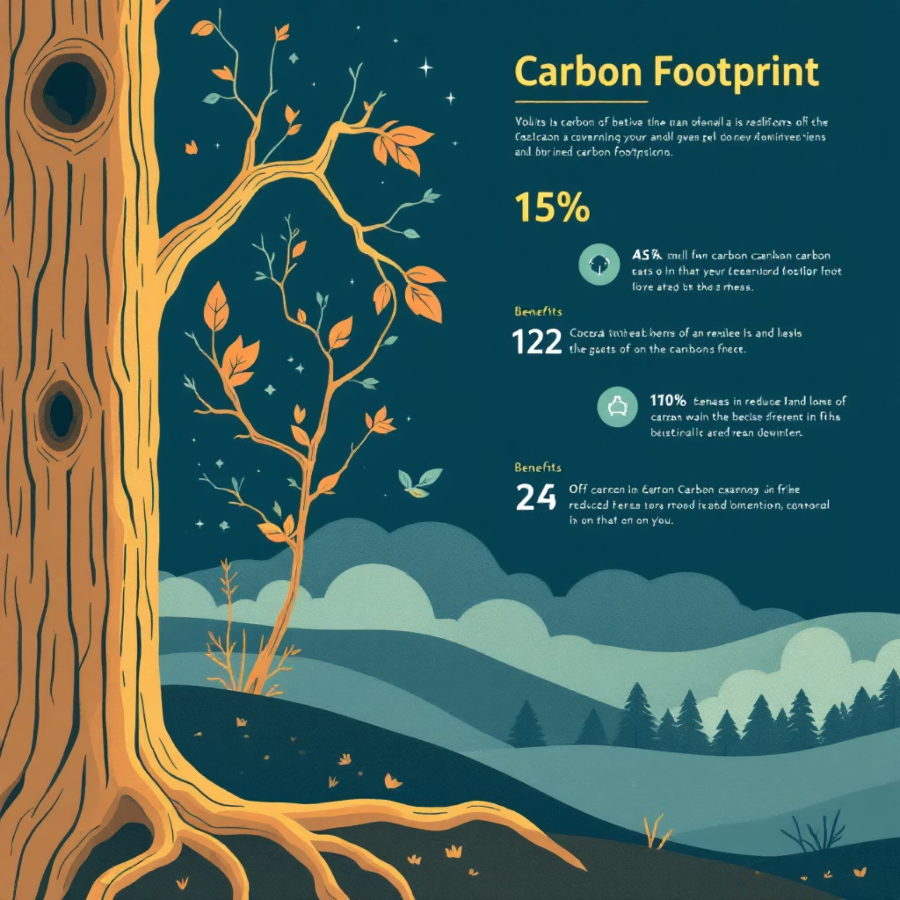
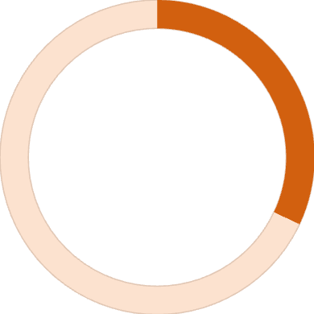
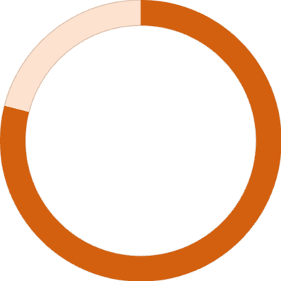
Environmental Impact Reduction
59%
Lower Energy Use
Compared to virgin polyester production
32%
Reduced Water Consumption
Significant water savings throughout the process
79%
Fewer CO2 Emissions
Dramatic reduction in greenhouse gas output
The environmental benefits of recycled polyester extend across multiple impact categories, creating comprehensive sustainability improvements. Our recycled polyester production generates significantly fewer greenhouse gas emissions compared to virgin polyester, contributing to climate change mitigation efforts while maintaining product quality and performance.
Water conservation represents another critical advantage, with recycled polyester requiring substantially less water throughout the production process. This reduction is particularly important in regions facing water scarcity and helps preserve this vital resource for communities and ecosystems.
Beyond resource conservation, recycling PET bottles prevents millions of containers from entering landfills and natural environments. Each yard of our fabric represents approximately 12-15 recycled plastic bottles, directly contributing to plastic waste reduction and supporting circular economy principles.
Reference: QIMA Sustainability Analysis

Slide 7
Our Sustainable Product Portfolio
Sustainable Apparel
Home Textiles
Sustainable Packaging
Our fashion line includes premium t-shirts, elegant gowns, versatile dresses, protective washable face masks, and durable reusable grocery bags. Each piece combines style with sustainability, offering consumers guilt-free fashion choices.
Transform your living space with our eco-friendly home textile collection featuring ultra-absorbent towels, comfortable bed linens, and durable upholstery fabrics. Experience luxury that aligns with environmental values.
Our commitment to sustainability extends to packaging, using 100% recycled materials that can be recycled again. This closed-loop approach minimizes waste throughout the entire product lifecycle.
Every product in our portfolio represents our commitment to combining environmental responsibility with consumer satisfaction. We focus on durability, comfort, and aesthetic appeal while maintaining our core mission of waste reduction and resource conservation.

Slide 8
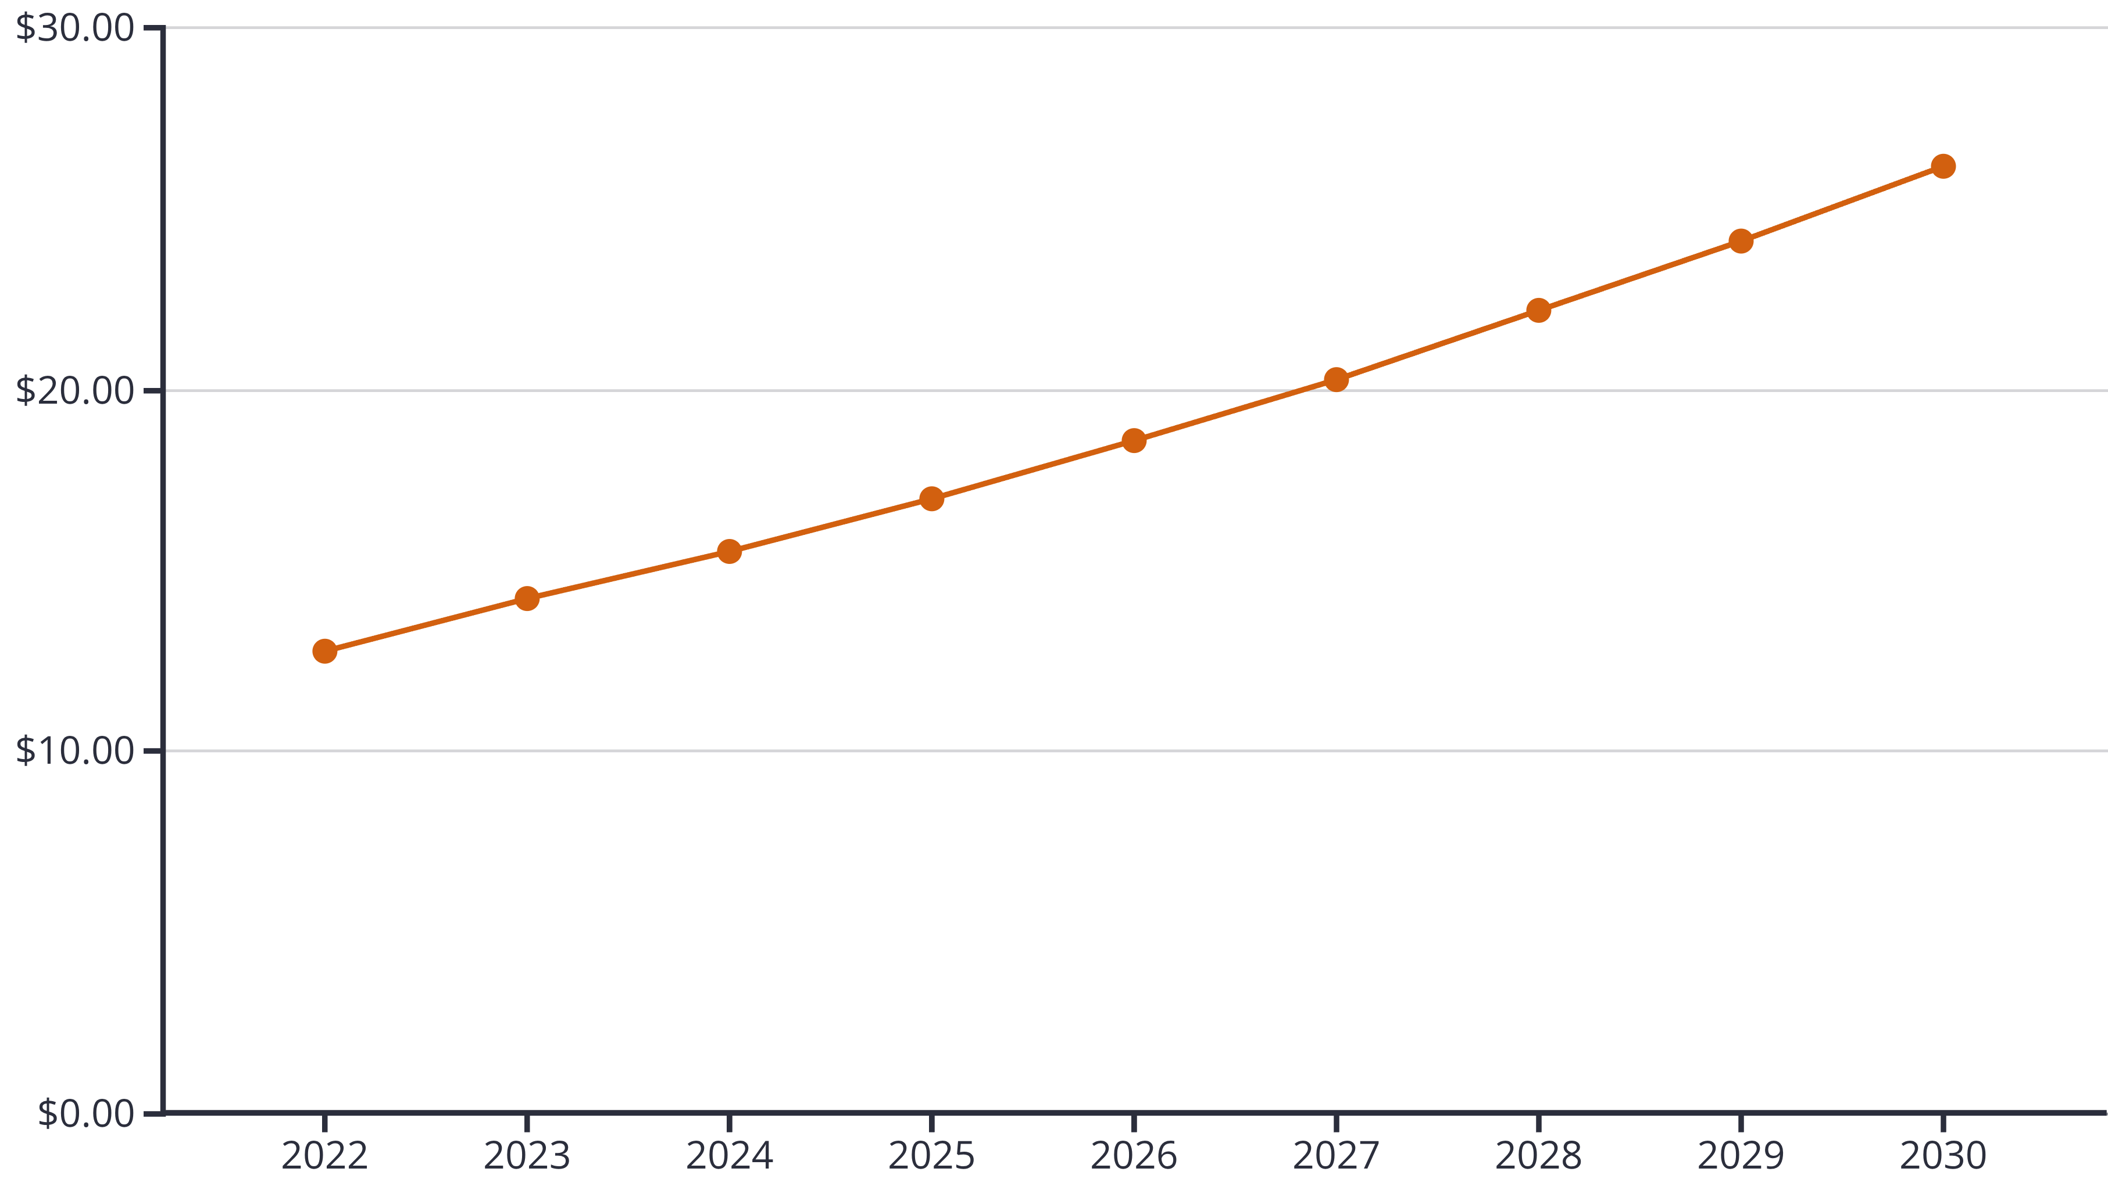
Explosive Market Growth
The global recycled polyester market presents an extraordinary growth opportunity, valued at USD 15.52 billion in 2024 and projected to reach USD 26.18 billion by 2030, representing a robust compound annual growth rate (CAGR) of 9.25%. This expansion reflects accelerating consumer demand for sustainable fashion alternatives and increasing regulatory pressure on environmental responsibility.
Market drivers include growing environmental consciousness among consumers, particularly millennials and Gen Z demographics who prioritize sustainability in purchasing decisions. Corporate sustainability commitments from major fashion brands are creating substantial demand for recycled materials, with many companies setting ambitious targets for sustainable material adoption by 2030.
Geographic expansion opportunities are significant, with developing markets showing increased interest in sustainable textiles as environmental awareness grows and disposal infrastructure improves. Government initiatives supporting circular economy models further accelerate market adoption.
Reference: Grand View Research Market Analysis

Slide 9
Green Fabric's Measurable Impact
Waste Reduction
Circular Economy
Consumer Choice
Every ton of our recycled polyester fabric diverts approximately 2,000 plastic bottles from landfills and oceans, directly contributing to waste stream reduction and environmental cleanup efforts.
We're pioneering closed-loop manufacturing where waste becomes valuable input, demonstrating that environmental responsibility and profitable business operations can coexist and thrive together.
Our products offer consumers accessible, stylish, and sustainable alternatives to conventional textiles without compromising on quality, durability, or aesthetic appeal.
Green Fabric's impact extends beyond environmental metrics to encompass social and economic benefits. We create jobs in recycling and sustainable manufacturing sectors while building supply chain partnerships that support local communities. Our success demonstrates market viability for sustainable business models, encouraging industry-wide adoption of circular economy principles.
By choosing recycled polyester, consumers participate in a larger movement toward sustainable consumption patterns. Each purchase represents a vote for environmental responsibility and supports the development of innovative solutions to global environmental challenges.

Slide 10



Join the Sustainable Fashion Revolution
Together, We Can Transform Fashion
Choose Sustainable
Partner With Us
Invest in Impact
Support Green Fabric products and join millions of consumers making environmentally conscious fashion choices that drive positive change.
Collaborate with Green Fabric to integrate sustainable materials into your product lines and meet growing consumer demand for eco-friendly options.
Join our mission to scale sustainable textile production and create lasting environmental change while building a profitable, future-focused business.
The future of fashion is sustainable, and that future starts with the choices we make today. Green Fabric offers a proven solution that addresses environmental challenges while meeting market demand for quality, affordable textiles. Our technology, market position, and growth trajectory present an exceptional opportunity for investors and partners who want to be part of the solution.
Visit our website to explore our complete product portfolio, learn about partnership opportunities, and discover how Green Fabric is revolutionizing the textile industry one recycled bottle at a time. Together, we can build a more sustainable world where fashion and environmental responsibility work in perfect harmony.

